Slide 1
SYSTEM & DESIGN REVIEW
DroneOps Intelligence
Mission planning · live monitoring
incident analytics · advisory AI
Design → database → packages → states → demo workflows
Lê Quốc Thống · Giang Nguyễn Gia Khánh
Hà Quang Nghĩa · Đặng Đào Anh Đức
DroneOps Intelligence · FA26SE238 | Review 2 draft · 19 Oct 2026
01
Notes:
DroneOps Intelligence supports mission planning, pre-flight validation, live monitoring, incident handling, post-flight reports and advisory AI. This review presents the system and database design, package responsibilities, state transitions and the main workflow demonstrations.

Slide 2
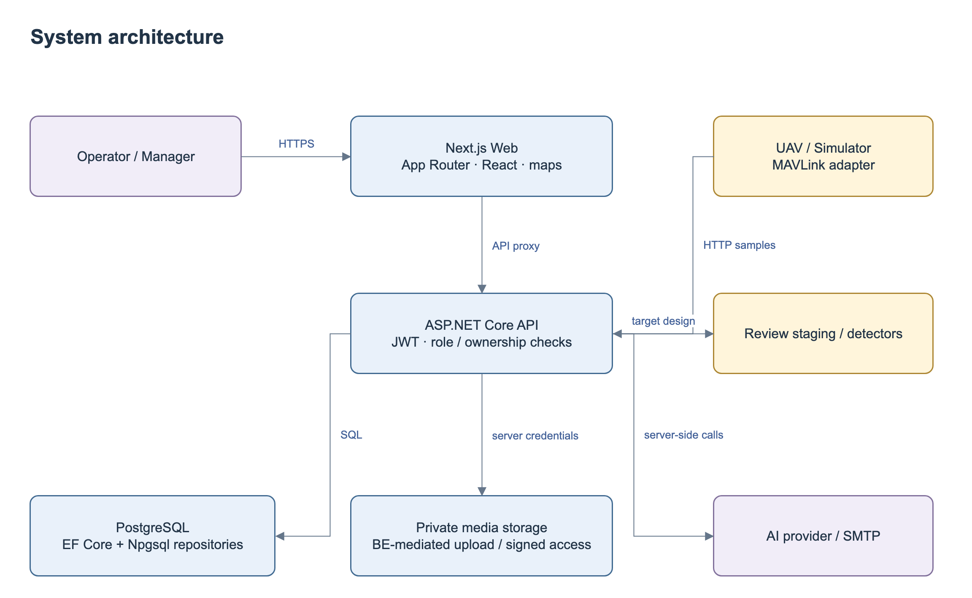
ARCHITECTURE
System design and integration boundaries
DroneOps Intelligence · FA26SE238 | Review 2 draft · 19 Oct 2026
02
Notes:
The browser communicates with the Next.js server and ASP.NET Core API. Application services enforce authorization and business rules, PostgreSQL stores operational records, and backend adapters handle private media, email and AI. The telemetry gateway supplies normalized MAVLink-derived samples; SSE provides authorized live updates.

Slide 3
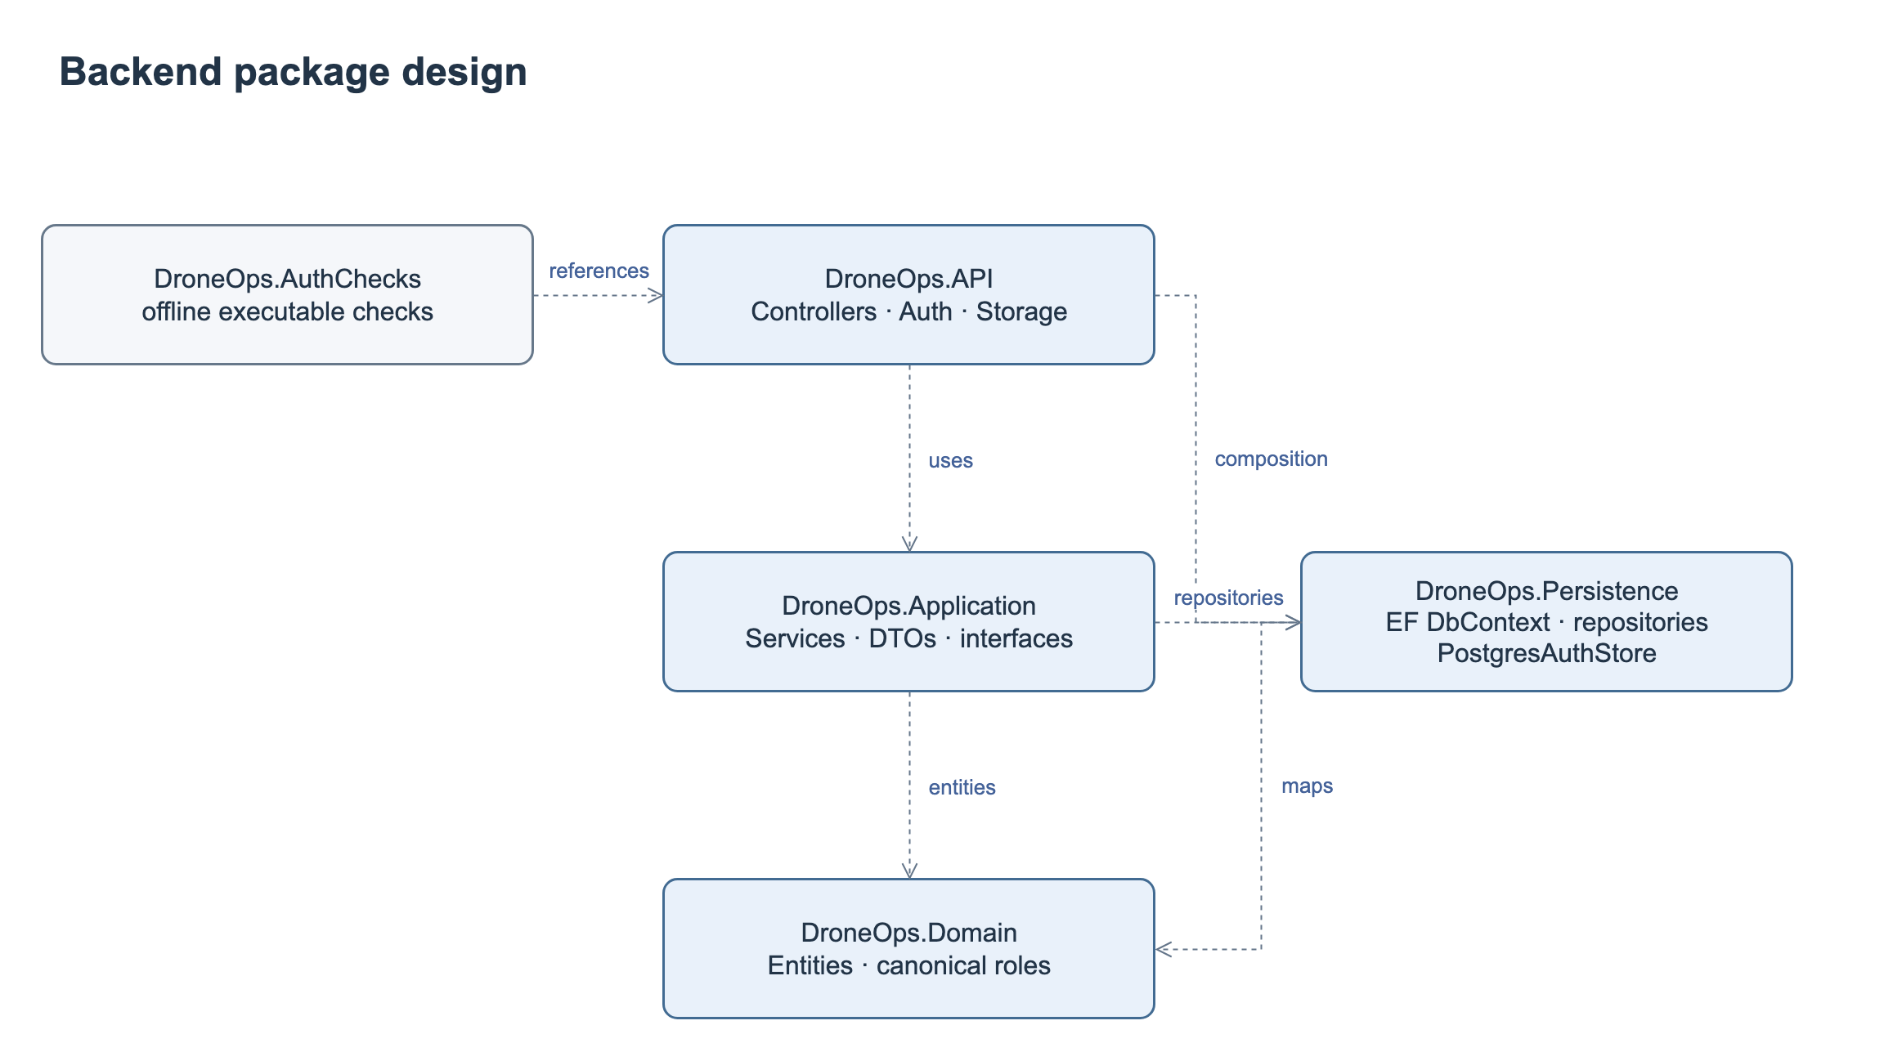
PACKAGES
Package design follows the actual repository
Web packages
Portal pages
↓
Shared clients
↓
API proxy
DroneOps Intelligence · FA26SE238 | Review 2 draft · 19 Oct 2026
03
Notes:
The API layer exposes controllers and configures dependencies. Application contains business services and DTOs. Persistence provides repositories, EF Core and Npgsql access. Domain defines operational entities. Frontend route components use shared clients and the API proxy.

Slide 4
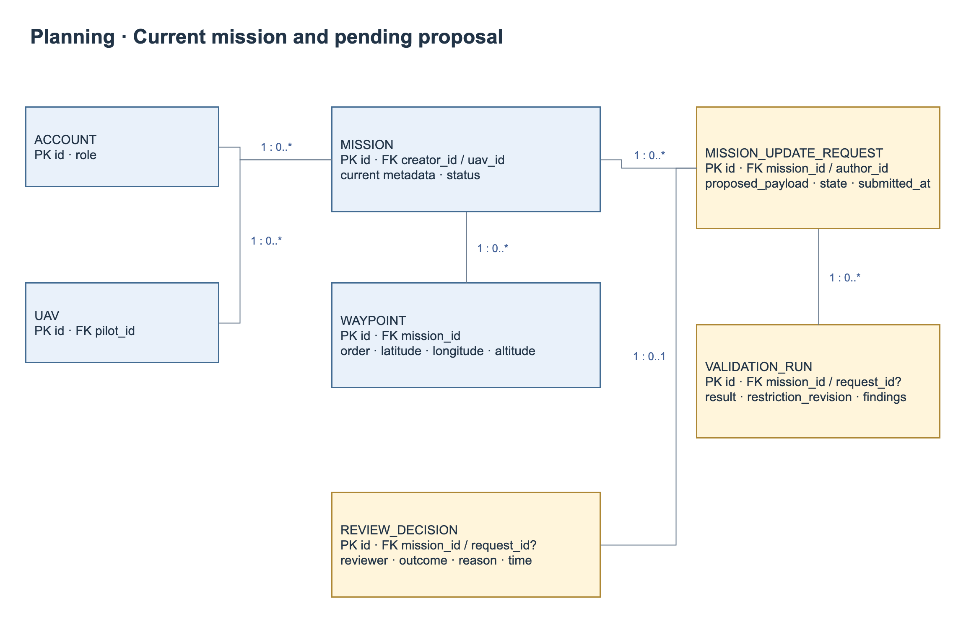
DATABASE DESIGN
Database: current content and proposed updates
DroneOps Intelligence · FA26SE238 | Review 2 draft · 19 Oct 2026
04
Notes:
A single Mission record contains the current plan. A separate update request stores changes awaiting review. Validation and reviewer decisions identify the exact request. Approval applies the complete accepted content atomically to the same mission; rejection preserves the current content.

Slide 5
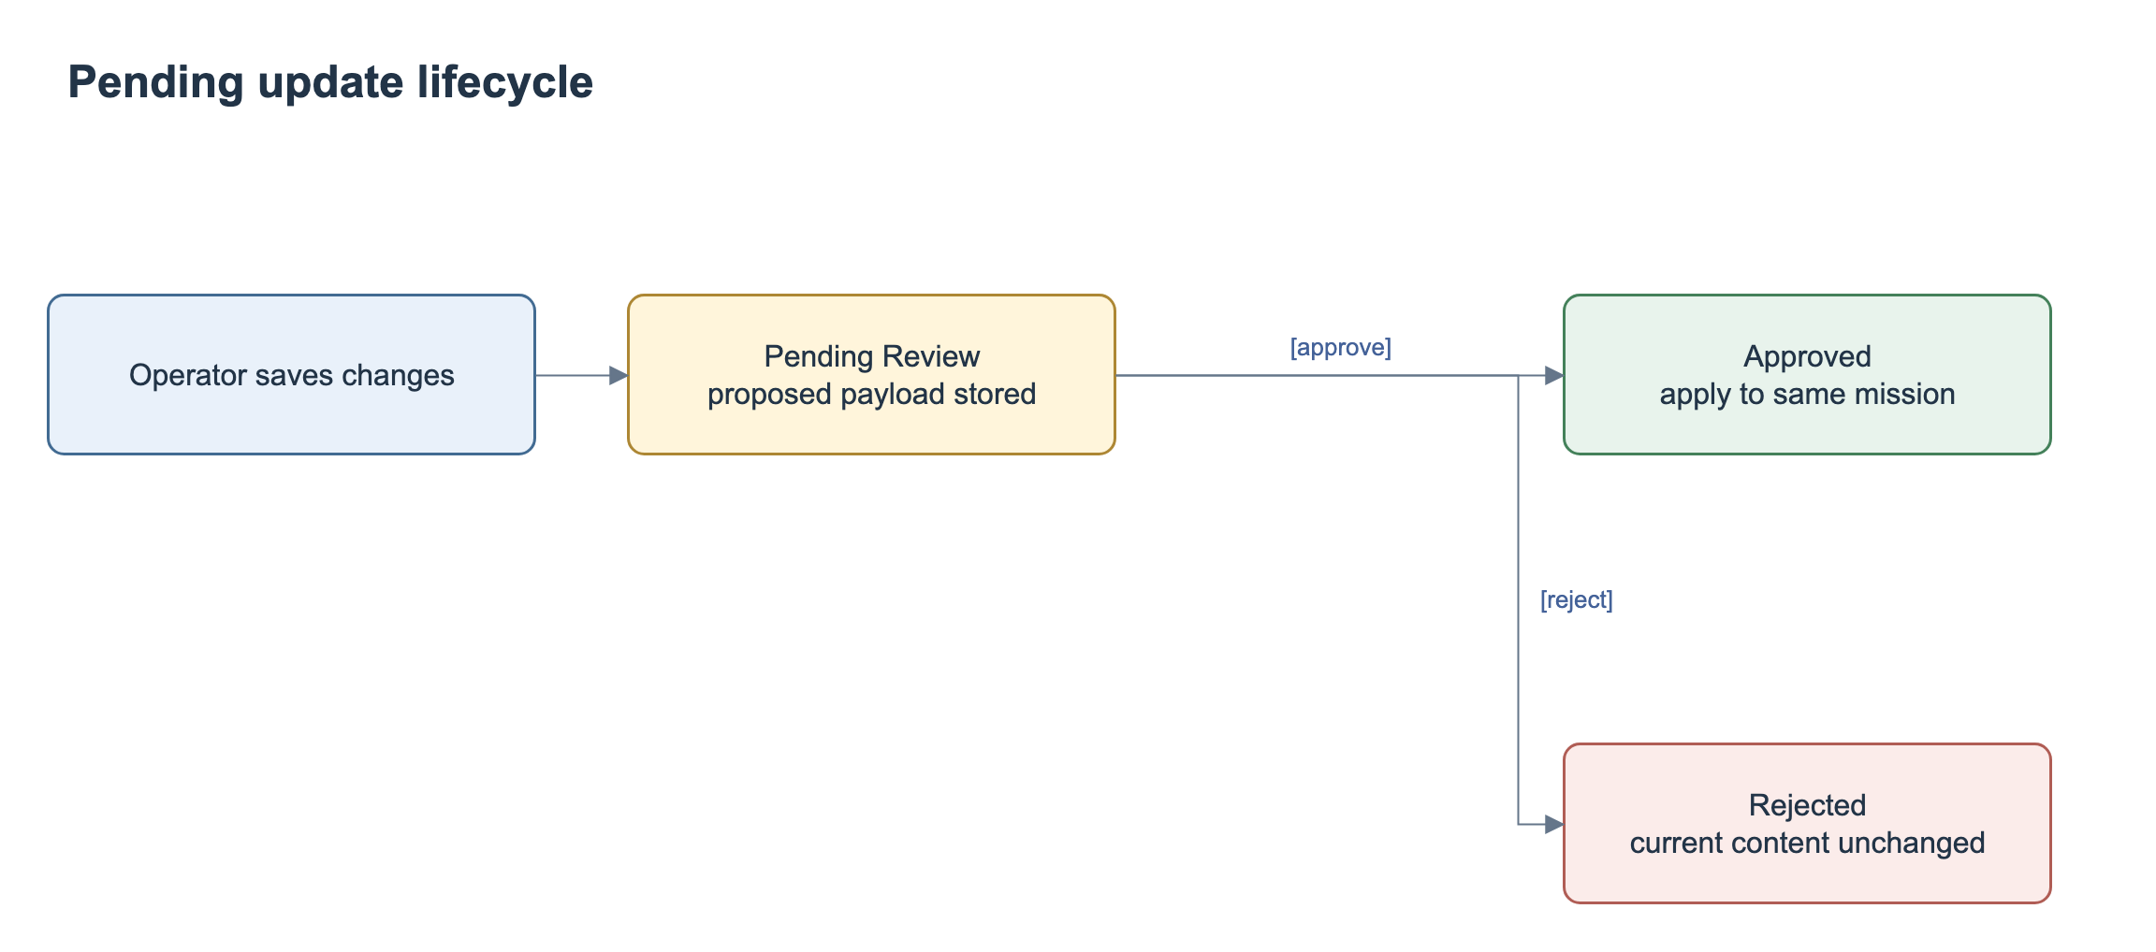
STATE DESIGN
Current mission and update request have separate states
Approved + rejected update → original content and approval remain
DroneOps Intelligence · FA26SE238 | Review 2 draft · 19 Oct 2026
05
Notes:
The current mission and pending update have separate states. An Approved mission remains Approved while an update is pending. If the update is rejected, its existing content and approval remain effective. If accepted, the same mission receives the approved changes.

Slide 6
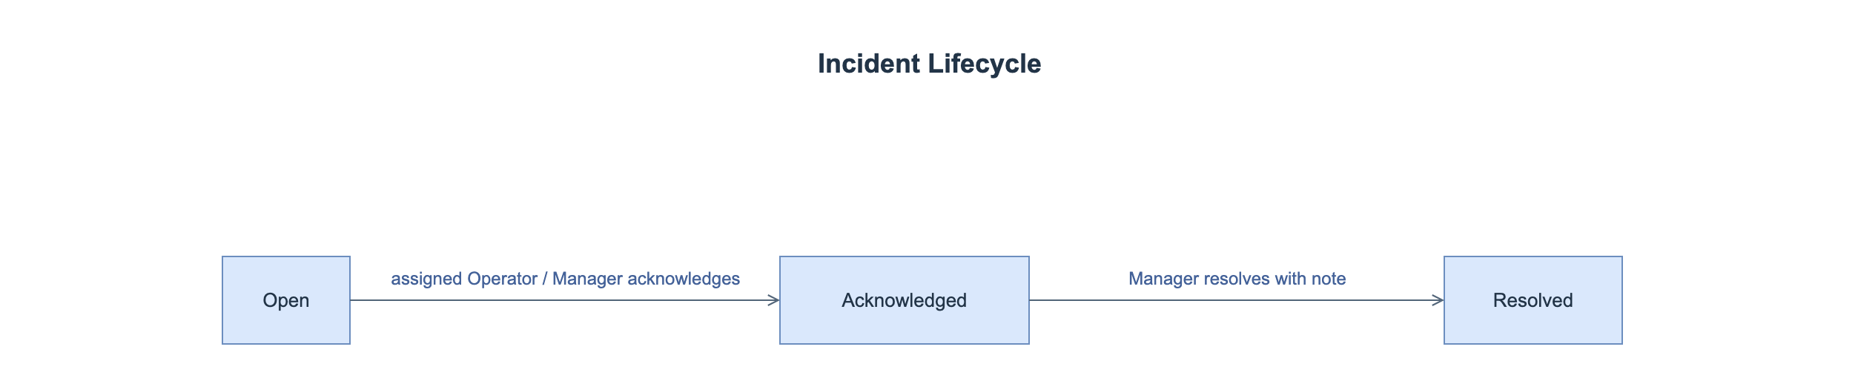
STATE DESIGN
Incident states preserve source evidence
Frozen evidence + actor/time/reason + durable alerts
Target actions still require API and FE integration.
DroneOps Intelligence · FA26SE238 | Review 2 draft · 19 Oct 2026
06
Notes:
An incident moves from Open to Acknowledged and then Resolved. Acknowledgement records the responsible user and time. Manager resolution requires a reason. State changes do not modify the frozen telemetry evidence.

Slide 7
WORKFLOW DEMO · MF1
Workflow A–C: review every mission update
1 · Save update
2 · Review
Store proposed content; send Manager review.
Compare old/new content and current validation.
3 · Reject
4 · Approve
Keep old content and prior Approved status.
Apply all accepted changes to the same mission.
DroneOps Intelligence · FA26SE238 | Review 2 draft · 19 Oct 2026
07
Notes:
First, the Operator saves the proposed changes. The Manager compares them with the current mission and validation findings. Rejecting the request keeps the existing content. Approving a request with current passing evidence applies its changes and records the decision.

Slide 8
WORKFLOW DEMO · MF2
Workflow D: telemetry → monitoring → incidents
Receive and persist
Monitor and reconnect
Authenticated normalized samples; source/receive times; deduplicate.
Latest snapshot + SSE; freshness, unavailable and offline states.
Detect and record
Handle and notify
Unit-aware rules; independent loss timer; frozen evidence.
Acknowledge → Manager resolve; durable alert and timeline.
DroneOps Intelligence · FA26SE238 | Review 2 draft · 19 Oct 2026
08
Notes:
The gateway supplies timestamped telemetry. The platform persists samples and publishes current state. Rules and an independent timer detect abnormal episodes and communication loss. Incidents retain frozen evidence, while acknowledgement, resolution and alerts provide a traceable handling process.

Slide 9
MF3 / MF4 DESIGN
History and AI retain a traceable evidence chain
Post-flight history
Advisory AI
Known telemetry fixture → report metrics, incidents and coverage.
Authorized context → provider result or explicit unavailable state.
Open scope item: registered Top-k similarity evidence versus current provider-only integration.
DroneOps Intelligence · FA26SE238 | Review 2 draft · 19 Oct 2026
09
Notes:
Post-flight reports use persisted telemetry and incidents, with coverage and missing metrics shown explicitly. AI assessments retain their mission context, provider and time. AI advice cannot approve a mission. The registered similarity-retrieval scope remains a review question recorded separately from the unchanged registration form.

Slide 10
TEST PLAN DRAFT
Test design targets the critical invariants
Mission invariants
Realtime reliability
Reject preserves current data; approve applies atomically; stale evidence blocks.
Out-of-order/replay, null metrics, no-packet timeout and reconnect.
40 planned integration/system cases + 10 unit designs
All Pending — capture tagged build, fixtures, logs and actual results.
CI: .NET build / analyzers / offline checks; FE lint / types / tests / build.
DroneOps Intelligence · FA26SE238 | Review 2 draft · 19 Oct 2026
10
Notes:
The test design includes 40 integration/system cases and 10 unit designs. The priorities are rejection preservation, atomic approval and rollback, scope enforcement, route validation, telemetry ordering and communication-loss timing. These planned cases require execution records before results can be reported.

Slide 11
DEMO PREPARATION
Workflow demonstration sequence
1. Create a mission and submit it for pre-flight validation.
2. Reject an update and verify the approved content is preserved.
3. Approve an update and verify the current mission changes.
4. Monitor telemetry and inspect incident evidence.
5. Review the post-flight report and AI assessment.
DroneOps Intelligence · FA26SE238 | Review 2 draft · 19 Oct 2026
11
Notes:
The workflow demonstration follows five steps: create and submit a mission, reject an update while preserving approved content, approve an update to the same mission, inspect monitoring and incident evidence, and review the post-flight report and AI assessment.

Slide 12
REVIEW CLOSURE
Decisions and next actions for Review 2
Agree the mission update and review rules.
Validate geometry, altitude references and boundary handling.
Complete gateway, monitoring and incident integration.
Execute test cases and record measurable results.
Review database migrations and deployment configuration.
DroneOps Intelligence · FA26SE238 | Review 2 draft · 19 Oct 2026
12
Notes:
The next steps are to agree the review rules and spatial constraints, complete the integration boundaries, execute the test plan, and review database migrations and deployment settings.

